Slide 1
Beginning Programming 1 With Python session 1

Slide 2

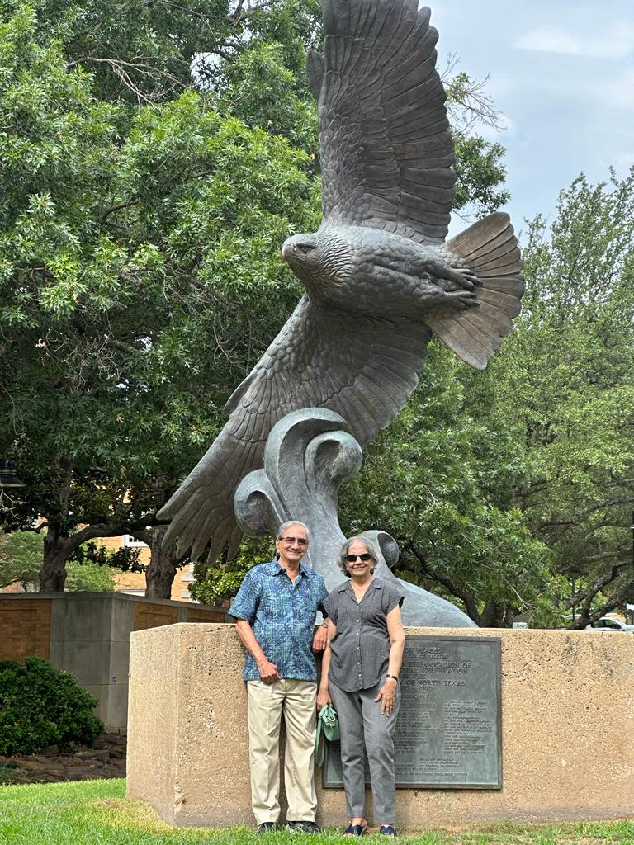

About Me
Ph.D., Management
Area of Research: Quality Assurance in Higher Education
M.S., Physics
Area of Research: Material Science
Chair, Dept. of Physics (Retd.), 14 yrs
Chair, Dept. of Information Technology (Retd.), 10 yrs
Over 35 yrs of teaching experience as Associate Professor Of Physics at the undergraduate level, including 12 years at the graduate level.
Teach Computer Programming (C, C++, Python, SQL, Web programming)

Slide 3
Certified Entry Level Python Programmer PCEP 30-02
Computer programming and Python Fundamentals: 18%
Control Flow(conditional statements and loops): 29%
Data Collections(Lists,Tuple,Dictionaries,Strings):25%
Functions and Exceptions: 28%
Duration: 40 minutes (exam) + 5 minutes (Non-Disclosure Agreement/Tutorial)
Number of Questions: 30
Format: Single-choice and multiple-choice questions | Python 3.x
Passing Score: 70% (PCEP -30-02 live and active)

Slide 4
Programming Languages
The concept of computer programming is logical and mathematical in nature.
Program is a set of instructions. The high level description of instructions becomes a program.
It is written in high level language which is closer to natural language like English.
Some of the high level languages are Fortron, Cobol,C,C++,C#,Java and now python.

Slide 5
Something more …
The simple HIGH LEVEL code is source code.A program called interpreter translates the source code to machine code when user runs the program.
Machine code is a binary sequence of zeros and ones and the computer system only understands machine code.
An interpreter will translate source code to machine code each time user runs the program.Interpreter based languages are useful for explorative development ,hence for beginner programmers.

Slide 6
Interpreter and Compiler
The compiler translated program runs many times with no additional translation and is faster. It creates an executable file once ,which can run many times with no additional time needed

Slide 7
Editors….Debuggers….Profilers…
Editor is a program which allows the programmer to enter the source code and save it to a file.
Programmer has to follow strict syntax rules to create a well formed program.
Else the editor points out syntax errors during editing. Colors and annotations are used to alert the programmer.
Debuggers allow the programmer to see which line in the source code is responsible for generating errors.
Profiler is used to find the part of the program that can be improved to make the program run faster.

Slide 8
Intergrated Development Environment
Many developers use the Integrated Development environment (IDE).
IDE includes Editors, debuggers and other aids in one comprehensive program.
Python IDEs are ,
IDLE
Wing IDE -101
En thought
We will be using IDLE

Slide 9
Installation of Python
To install :
1] www.python.org
2] Anaconda platform, which is more than just Python. It can be installed on Windows, Mac OS and Linux machine.
Use the latest Anaconda version, Python3.6 and 64-bit. https://www.anaconda.com/download/ Windows installation instructions: https://docs.continuum.io/anaconda/install/windows/

Slide 10
About Python
Guido Van Rossum created Python in late 1980
Python 3.0 released in 2008
Python is beginning programmer's language and provides a powerful syntax compared to C,C++,C# etc.
It is interpreter based hence called scripting language like Ruby,Pearl,Javascript
On the other hand C,C++,C#,Java are compiler-based languages.
Python is used in most video games, web apps and search engines.

Slide 11
Our goal for these 12 sessions……….
To learn basic skills and the syntax of this higher-level language.
Programming skills will be able to foster creativity, reasoning and problem-solving abilities among the learner.
Programming will be fun and can be challenging
We will be using Python 3.11.6 version with IDLE

Slide 12
What Is A Program?
A program is a sequence of instructions that specifies how to perform a computation.
Computation may be mathematical calculation or a symbolic computation such as searching or processing an image.

Slide 13
Basic building blocks of python program
Numeric values
Strings (nonnumeric)
Assignment
Variables
Identifiers
Reserved words

Slide 14
Something more
Numeric values are numbers, integers and floating point
Strings are nonnumeric, list of characters, numbers…
Variable is a value stored in computer's memory.
Identifiers can be variable name, function name, class or method name…it is a word used to name things.
Reserved words or Keywords are special words reserved for special use like …if, else, elif, for, class,….return, def, while

Slide 15
Comment, expression, statement…..
Comments start with # symbol and explain in natural language what the program is doing.
Ex:# This program calculates sum of two numbers and its product
An expression is combination of variables ,operators and values. An interpreter evaluates the expression and finds its value.
Ex: n+25
Statement on the other hand produces an action or effect
Ex: n=17
print(n)

Slide 16
Assignment Statement
An assignment statement creates a new variable and gives it a value.
myname= "vinita" (value is a string)
salary= 5500 (value is numeric and integer )
bill= 34.59 (value is numeric but float)
myname
vinita

Slide 17
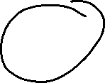
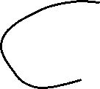
How Assigning value changes during the program
a=2
b=5
a=3
a =b
Graphical representation of a set of variables and values they refer to is called State Diagram.
a
2
b
5
a
3
a
5

Slide 18
Sample Program
#This program tells myname and it asks yourname?
myname= "Vinita"
yourname=input("What is your name?\n")
print("my name is",myname,"your name is",yourname)

Slide 19
Here it goes…..
In this sample program yourname and myname are variables.
They are named values that can change.
Value is stored in computer’s memory.
Variables can be numeric and strings ( letters, numbers, words, sentences)
Variable name begins with letter or underscore and you cannot have a space or any other character inside a variable name except underscore.
input ( ) function tells Python that the user should enter some information through the keyboard when the program is running.

Slide 20
How to run the Python Program?
Python can run in interactive mode which means user interacts directly with the interpreter using COMMAND LINE….
But for more than few lines of code this mode can be clumsy…..
User then writes the code, saves in script file and runs the interpreter in script mode to execute the script.
Python scripts have name that ends with .py
To display the result user has to write print statement

Slide 21
Basic operators
The basic Arithmetic operators are :
+(addition)
-(subtraction).
*(multiplication)
/ (division)
**(Exponentiation)
// Floor division yields an integer division
% modulus operator which gives remainder after the division
When an expression contains more than one operator, order of evaluation depends on order of operation as given by PEMDAS where Parentheses has highest preference.
Operators with same preference are evaluated from left to right except exponentiation.

Slide 22
Math Operation 1
#math operations
num1= float(input("enter first number\n"))
num2= float(input("enter second number\n"))
sum=num1+num2
diff=num1-num2
product=num1*num2
div=num1/num2
print("sum of two numbers is\n",sum)
print("difference of two numbers is\n",diff)
print("product of two numbers is\n",product)
print("quotient of two numbers is\n",div)

Slide 23
Math Operation 2
num1= float(input("enter first number\n"))
num2= float(input("enter second number\n"))
intdiv=num1//num2
mod=num1 % num2
exp=num1** num2
print("integer quotient of two numbers is\n",intdiv)
print("remainder of two numbers is\n",mod)
print("exponential of two numbers is\n",exp)

Slide 24
Relational Operators
Relational operators have lower precedence than Arithmetic operators.
== mathemetical equality
< less than
<= less than equal to
> greater than
>= greater than equal to
!= Not equal to

Slide 25
PEMDAS CONVENTION
2*(3-1)=4
(1+1)**(5-2)=8
1+2**3= 9 not 27
2*3-1=7 not 4
6+4/2=8 not 5
Relational operators have lower precedence than arithmetic operators

Slide 26
Floating Point Numbers
Python supports non integers called floating point numbers.
Floating point numbers have definite bound unlike integers.
Round function can add or subtract fractional amount as necessary to produce integer closest to the original floating-point number.
Ex: x=34.5678
a=round(x)
print(a)
b=round(x,1)
print(b)
c=round(x,3)
print(c)
d=round(x,-1)
print(d)

